Slide 1
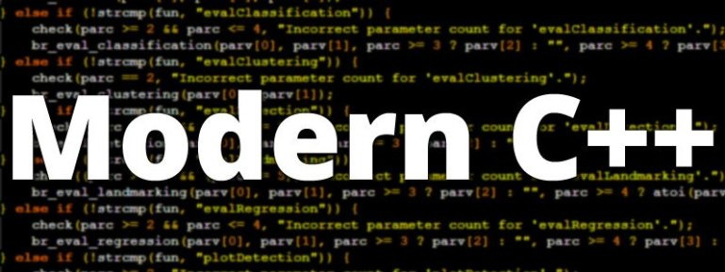
ADVAnce C++

Slide 2
MODERN C++
Containers In STL
Types Of Containers
Common Functions In Containers
Common Operators In Containers

Slide 3
Containers in stl
Containers in STL are the objects that hold a collection of values .
These values can be primitives or even objects of our classes.

Slide 4
Benefits of containers
They can be used to create arrays, growable array , stack ,queue , linked list , trees and many other data structures by writing minimum amount of code.
Moreover these classes contain predefined methods also which makes it very easy for a programmer to use these data structures in his program

Slide 5
An important point
Another point to remember about Containers is that they are template based classes, which means that they can work with collection of any type of data
Also , many Containers are dynamic in nature i.e they can resize themselves as and when required.

Slide 6
Types of containers
The C++ STL categorizes containers into four types and these types are:
Sequence containers
Sequence container adapters
Associative containers
Unordered associative containers

Slide 7
Sequence containers
Sequence Containers implement data structures that can be accessed sequentially, like arrays and linked list.
In STL we have 5 types of Sequence Containers and they are:
array : represents a static contiguous array
vector : represents a dynamic contiguous array
forward_list : represents a singly-linked list
list : represents a doubly-linked list
deque : represents a double-ended queue, where elements can be added to the front or back of the queue.

Slide 8
Sequence container Adapters
Sequence Container adapters, are classes created by restricting some functionality in a pre-existing container and providing a different set of functionality.
In STL we have 3 types of Sequence Container Adapters and they are:
stack : a container providing Last-In, First-Out (LIFO) access and it is by default based upon deque.
queue : a container providing First-In, First-Out (FIFO) access and it is also by default based upon deque.
priority_queue: a container specifically designed such that its first element is always the greatest of the elements it contains. It is by default based upon vector.

Slide 9
associative containers
Associative containers are nonlinear data structures that typically can locate elements stored in the containers based upon a given information.
They store data as key–value pairs in which each key has an associated value—for example, a program might associate the ROLLNO with STUDENT NAME.

Slide 10
associative containers
In STL we have 4 types of Associative Containers and they are:
set : represents a collection of unique keys
map : represents a collection of key-value pairs with keys unique
multiset: represents a collection of keys with duplicates allowed
multimap : represents a collection of key-value pairs where duplicate keys are allowed

Slide 11
Unordered associative containers
Unordered Associative containers are unsorted data structures that can be quickly searched
The provide average access time as O(1) and even in the worst case it is O(n).

Slide 12
Unordered associative containers
In STL we have 4 types of Unordered Associative Containers and they are:
unordered_set : represents a collection of unique keys with hashing
unordered_map : represents a collection of key-value pairs with keys unique and hashed.
unordered_multiset: represents a collection of keys stored using hashing with duplicates allowed
unordered_multimap : represents a collection of key-value pairs where duplicate keys are allowed and keys are stored using hashing

Slide 13
First class containers
First-class containers provide a set of common characteristics and behavior in their implementation.
They have all are pure containers and in STL we have total seven first class containers and they are:
vector
dequeue
list
map
multimap
set
multiset

Slide 14
quizz
Three components in STL are ____________.
A. containers
B. iterators
C. algorithms
D. linked lists
E. vectors
Correct Answer:
A,B,C

Slide 15
quizz
Three types of containers are ____________.
A. sequence containers
B. linear containers
C. associative containers
D. container adapters
E. wrapper containers
Correct Answer:
A,C,D

Slide 16
quizz
Which of the following are sequence containers?
A. list
B. queue
C. deque
D. map
E. set
Correct Answer:
A,C

Slide 17
quizz
Which of the following are associative containers?
A. list
B. queue
C. deque
D. map
E. set
Correct Answer:
D,E

Slide 18
quizz
Which of the following are container adapters?
A. list
B. queue
C. deque
D. multimap
E. stack
Correct Answer:
B,E

Slide 19
Common functions for containers
Member Function | Purpose
Non-parametrized constructor | A constructor to provide a default initialization of the container.
parametrized constructor | Normally, each container has several constructors that provide different initialization methods for the container.
copy constructor | A constructor that initializes the container to be a copy of an existing container of the same type.
destructor | Destructor function for cleanup after a container is no longer needed.

Slide 20
Common functions for containers
Member Function | Purpose
empty() | Returns true if there are no elements in the container; otherwise, returns false.
size() | Returns the number of elements currently in the container.
swap() | Swaps the elements of two containers.
begin() | This function returns an iterator that refers to the first element of the container.
end() | This function returns an iterator that refers to the next position after the last element of the container.

Slide 21
Common overloaded operators for containers
Overloaded Operator | Purpose
operator= | Assigns one container to another.
operator== | Returns true if the first container is equal to the second container; otherwise, returns false.
operator!= | Returns true if the first container is not equal to the second container; otherwise, returns false.
operator> | Returns true if the first container is greater than the second container; otherwise, returns false.
operator< | Returns true if the first container is less than the second container; otherwise, returns false.

Slide 22
Common overloaded operators for containers
Overloaded Operator | Purpose
operator<= | Returns true if the first container is less than or equal to the second container; otherwise, returns false.
operator>= | Returns true if the first container is greater than or equal to the second container; otherwise, returns false.

Slide 23
Functions common in first class containers
Member Function | Purpose
rbegin() | This function returns a reverse_iterator that refers to the last element of the container.
rend() | This function returns a reverse_iterator that refers to the next position after the last element of the reversed container.
erase() | Erases one or more elements from the container.
clear() | Erases all elements from the container.
max_size() | Returns the maximum number of elements for a container.

Slide 24
Functions common in first class containers
Member Function | Purpose
begin() | This function returns an iterator that refers to the first element of the container.
end() | This function returns an iterator that refers to the next position after the end of the container.

